Slide 1

From Coursework to Comps
Ph.D. General Advising Session
Educational Policy Studies

Slide 2

Ph.D. Advising
Cultivating a relationship that works for you
Meet regularly so your advisor knows what’s going on in your life
Temporary – you have the option to switch advisors
Advisor’s signature must go on all of your forms (petition, program of study, etc.)

Slide 3
Doctoral Flow Chart
Doctoral Flow Chart
Program of Study & Doctoral Advisory Committee
Residency Form
Comprehensive Exam

Slide 4
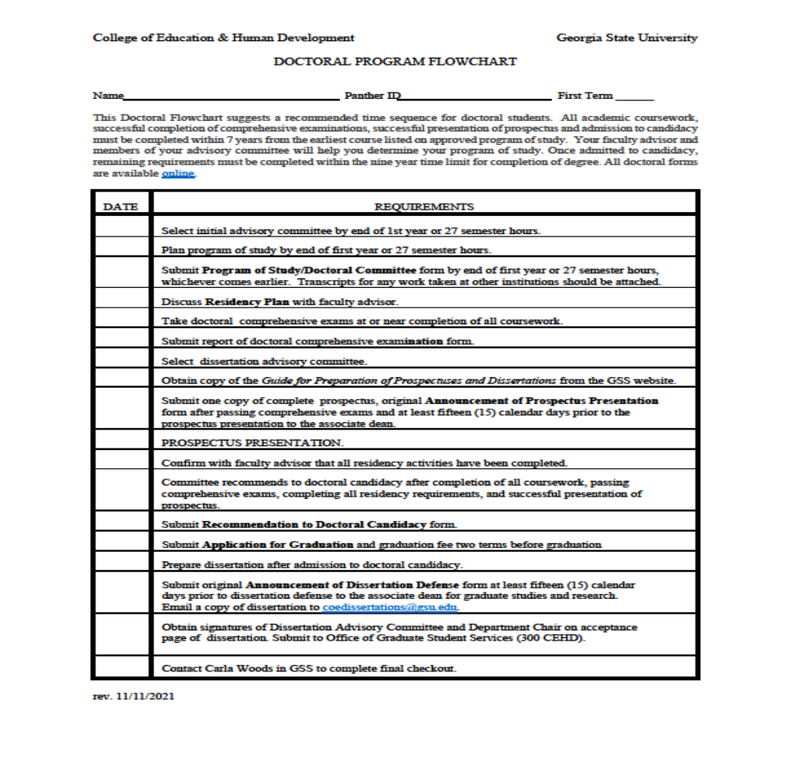
Doctoral Flow Chart
The flowchart can be used as a guide throughout your program

Slide 5
Program of Study
Due at the end of Year Two
EPS 9270 & EPS 9260 should be listed in Major area
Major area will be 24 credit hours total
Consult with faculty advisor about what courses you should take
Two advanced courses are needed in the Research Core
Complete Catalog requirements are located here
Your Academic Evaluation/DegreeWorks will be updated after your Program of Study form is submitted

Slide 6
Cognate
Cognate courses can be taken anywhere within GSU
CEHD courses must be 8000 level or higher
Graduate level courses outside of CEHD may be 6000 level or higher
Cognate area is 12 credit hours

Slide 7
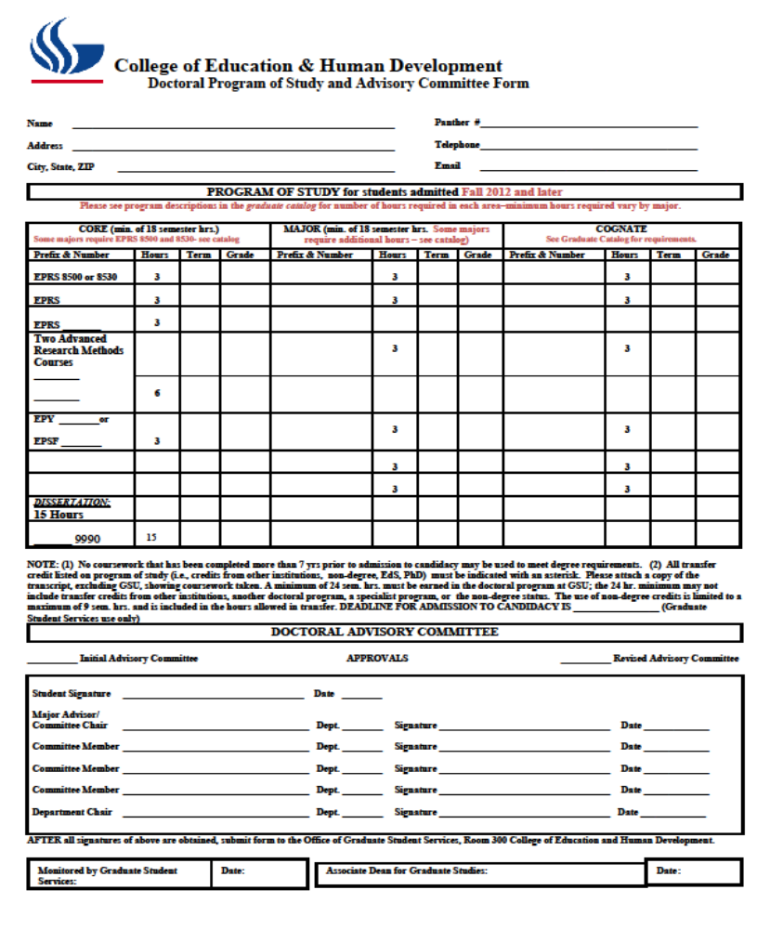
Doctoral Advisory
Committee Makeup
Three members needed initially
Only one outside member allowed
Two members must be from CEHD
Click here to download form

Slide 8
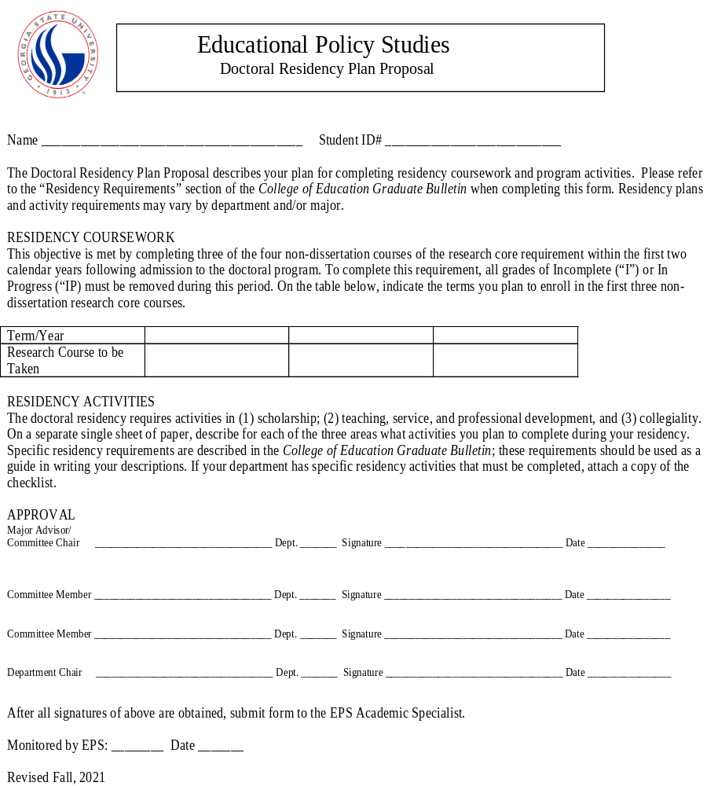
Residency Form
Scholarship
  Participate in a faculty research project
  Write a presentation or publication
  Collect data for a research project
  Do a research project (other than your dissertation)
Teaching, Service, and Professional Development
  Work with faculty to teach a course
  Serve on department and/or CEHD committee
  Attend doctoral seminars
  Serve as an intern in an outside agency
  Assist in planning a conference or colloquium
  Conduct a workshop, develop a seminar
Collegiality
  Attend departmental meetings
  Participate in fall and springs mixers
  Contribute to the graduate student association
  Participate in departmental and other college functions
Complete form may be found here

Slide 9
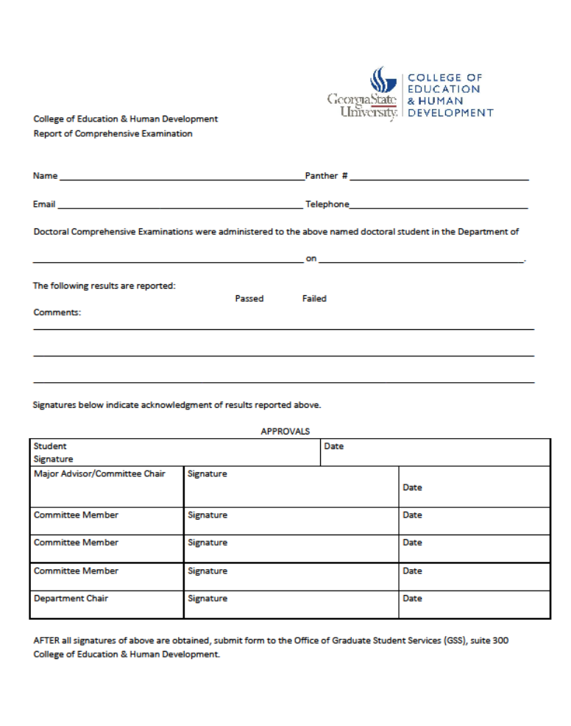
Comprehensive Exams
Students must defend Comps during the same semester it is started
The majority of coursework should be complete prior to taking the Comprehensive Exam
A student’s cumulative gpa in the doctoral program of study must be no less than 3.50 in order to take the Comprehensive Exam
Students must notify the department chair in writing of their intention to take the Comprehensive Exam by September 15 for Fall semester or February 1 for Spring semester
Students may not complete Comprehensive Exams during the Summer semester
Faculty need two weeks to read all responses prior to defense
Dissertation hours may not be taken until after Comp Exams are complete
View complete Comprehensive Exam policy here and form here

Slide 10
Continuous Enrollment
Students Must be registered for 6 hours over a three semester time period (including summers)
Students Must be registered for at least one hour during dissertation defense semester
If a student falls out of compliance, a Re-Entry Application will be needed
Please communicate with your advisor if you do not register for courses during any semester or if you are only taking one course a semester.

Slide 11
Key Reminders
After obtaining signatures of your committee chair and members, you may return forms to Damien Lawrence dlawrence@gsu.edu for the Department Chair’s signature
Dissertation courses require authorization; prior to registering each semester contact Damien Lawrence dlawrence@gsu.edu for authorization
Students should apply for graduation two terms prior to graduation; applications may be submitted via PAWS

Slide 12
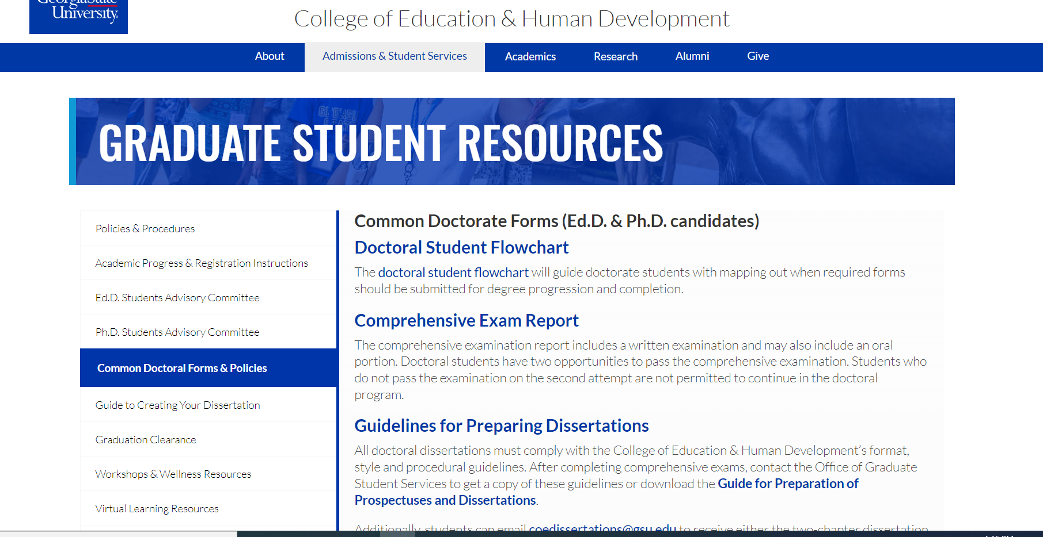
Graduate Student
Resources
All forms are located on the Graduate Student Resources site
https://education.gsu.edu/admissions/graduate-student-resources/

Slide 13
Graduate Certificates
Program Evaluation Certificate
Qualitative Certificate
Quantitative Certificate
Courses taken for certificates can also apply towards program of study for your degree

Slide 14
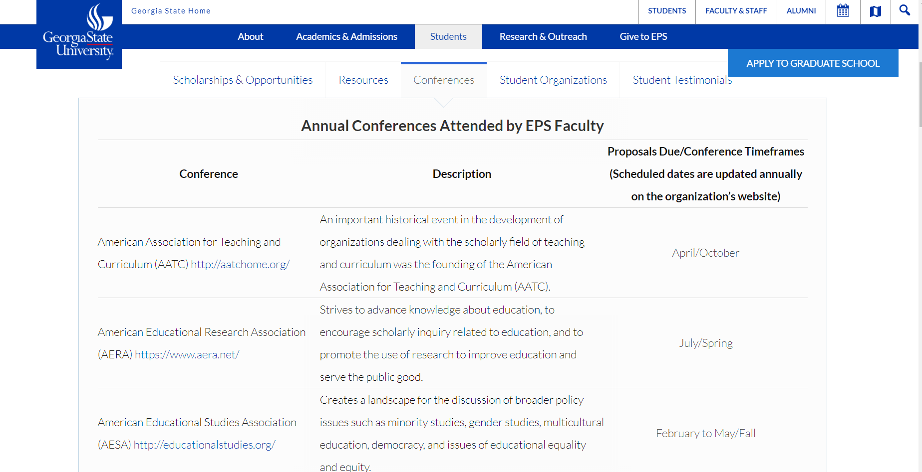
Conferences
https://education.gsu.edu/eps/epsstudents/#eps-conferences

Slide 15
Any Questions?

